Slide 1

Non-Contact Authentication System for Controlled Laboratory Environments
Team: TinkerTribe
Sakshi Gupta · Yash Patwardhan · Aayushi Choudhary
A design-thinking, engineering-focused approach to touchless access verification

Slide 2

Problem Identification -Operational Constraints & Risks
Current Methods
Laboratory Constraints
RFID badges, contact fingerprint readers, and camera-based face recognition are widely used.
Contamination risk, PPE requirements, chemical environments, and glove use make contact biometrics impractical.
Operational Needs
Touchless, hygienic, non-wearable, robust to PPE, and compatible with controlled atmosphere protocols.

Slide 3
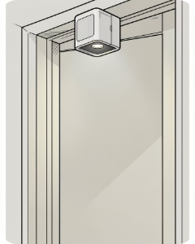
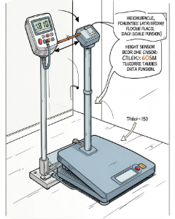
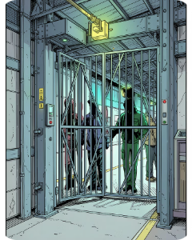
SCAMPER Applied - Key Design Decisions
Substitute
Combine
Adapt / Modify
Replace contact/wearable methods with passive physical profile (height + weight) to enable touchless verification.
Fuse laser/optical height sensing and precision load-cell weight reading for a two-factor physical signature.
Adapt safety gate and industrial weighing concepts; modify access flow to verify person directly before badge read.

Slide 4
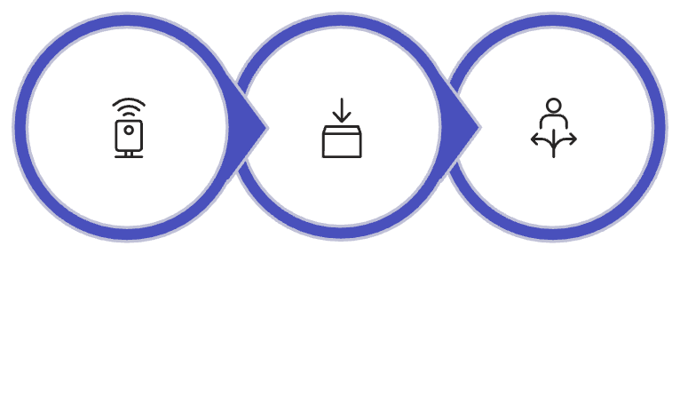
SCAMPER (cont.) - Implementation, Validation & Next Steps
Eliminate
Put to Another Use
Reverse / Rearrange
Remove physical ID contact points, fingerprint readers, and manual touch interactions -reducing contamination vectors.
Leverage existing safety scales and ceiling-mount sensors for authentication and environmental monitoring.
Verify person by physiological profile first, then log access to digital identity-reducing dependency on carried tokens.
Height Scan
Weight Capture
Profile Match
Three-stage flow minimizes false accepts: capture → fuse → decision. All steps are non-contact and operate with PPE.
Validation Plan & Next Steps
Prototype in controlled lab with 200+ samples (PPE variants)
Tune fusion algorithm (thresholds, adaptive filtering)
Safety & privacy assessment; fail-safe override & audit trail

